Slide 1

SHARED VISI N
Jesuit Spirit in Education
Session 4
[NAME of SCHOOL] – A Jesuit School
Notes:
Shared Vision Induction
Session 4 – [NAME of SCHOOL] – A Jesuit School

Slide 2

Stop for a moment.
Pause.
Step back.
Take a breath.
What have the events of today left you thinking?
How have they left you feeling?
What is it you desire from the next hour or so?
Be still.
Notes:
[Especially if people are coming to this session from a busy day, it may be good to do a quick relaxation/focus exercise to begin. This need be no more than closing one’s eyes and adopting a relaxed but alert sitting position. Then read the following phrases slowly with pauses in between (they are also on the screen for those who can’t shut their eyes!)]
Stop for a moment. Pause. Step back. Take a breath. What have the events of today left you thinking? How have they left you feeling? What is it you desire from the next hour or so? Be still.
[click – next slide]

Slide 3


identity
a story to enter
a language to speak
is about who we are
mission
a work we do
a face of God to see
is about what we do
community
mission
identity
community
is about the way we
are with each other
a group to which to belong
a way of proceeding
Notes:
In the first session of SVi, we saw that one way of thinking about the vision of Jesuit education is to think about the school’s identity, mission and community.
[click]
Identity is about who we are.
The school’s identity comes from its Jesuit roots; from its history since it was founded in [YEAR]; and from the countless interwoven stories of the teachers, staff and pupils who have spent part of their lives making it what it is today. The school’s identity is seen in its story and also in the language we use to describe who we are and what we do.
[click]
Mission is about what we do.
A school’s mission happens in the things we do every day: in our classrooms, laboratories, practice rooms, workshops and studios, gyms and playing fields; in the numerous interactions, casual and pastoral, between teachers and pupils; in the routines and events which mark out the school day, week, term and year. And, every so often, in the set-piece events which see the school brought together and the talent and enthusiasm of our pupils and staff shown off at their best. The mission of a Christian school, a Jesuit school, is to show the face of God in the everyday. And it does this through the work of education of mind and formation of character that we undertake.
[click]
Community is about the way we are with each other.
A community is somewhere we belong. And the community should reflect our identity and mission. The way we do things, the way we carry out our mission according to our identity, Ignatius calls ‘our way of proceeding’. It is about the way we treat each other, the way we go about the business of teaching and learning, and of forming good and virtuous young people who will be men and women for others.
[click – next slide]

Slide 4
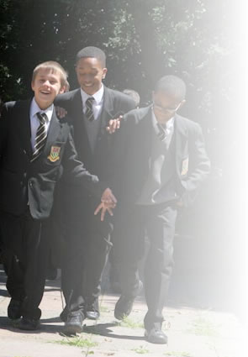
1
St Ignatius College
The story of a Jesuit school
Notes:
Identity – title slide
[click – next slide]

Slide 5
Titles : Calibri 36pt
Text : Calibri 24pt
Quotations : Constantia 24pt blue
Quotation references : Calibri 14pt grey
I D E N T I T Y
Notes:
Identity – template slide
[click – next slide]

Slide 6

I D E N T I T Y
Xxxx
Xxxx
Xxxx
Notes:
Pause for thought.
[5-minutes to reflect and share with the person next to you]
[click – next slide]

Slide 7

“A distinctive spirit still marks any school which can truly be called Jesuit.
This distinctive spirit can be discovered through reflection on the lived experience of Ignatius, on the ways in which that lived experience was shared with others, on the ways in which Ignatius himself applied his vision to education, and on the ways in which this vision has been developed and applied to education in the course of history, including our present times.
A common spirit lies behind pedagogy, curriculum and school life, even though these may differ greatly from those of previous centuries, and in detail from country to country.”
I D E N T I T Y
The Characteristics of Jesuit Education n.8
Notes:
Identity – end of section slide
“A distinctive spirit still marks any school which can truly be called Jesuit.
This distinctive spirit can be discovered through reflection on the lived experience of Ignatius, on the ways in which that lived experience was shared with others, on the ways in which Ignatius himself applied his vision to education, and on the ways in which this vision has been developed and applied to education in the course of history, including our present times.
A common spirit lies behind pedagogy, curriculum and school life, even though these may differ greatly from those of previous centuries, and in detail from country to country.” (The Characteristics of Jesuit Education n.8)
[click – next slide]

Slide 8
2
St Ignatius College
Jesuit education in north London
since 1892
Notes:
Mission – title slide
[click – next slide]

Slide 9
Titles : Calibri 36pt
Text : Calibri 24pt
Quotations : Constantia 24pt blue
Quotation references : Calibri 14pt grey
M I S S I O N
Notes:
Mission – template slide
[click – next slide]

Slide 10
M I S S I O N
Xxxx
Xxxx
Xxxx
Notes:
Pause for thought.
[5-minutes to reflect and share with the person next to you]
[click – next slide]

Slide 11
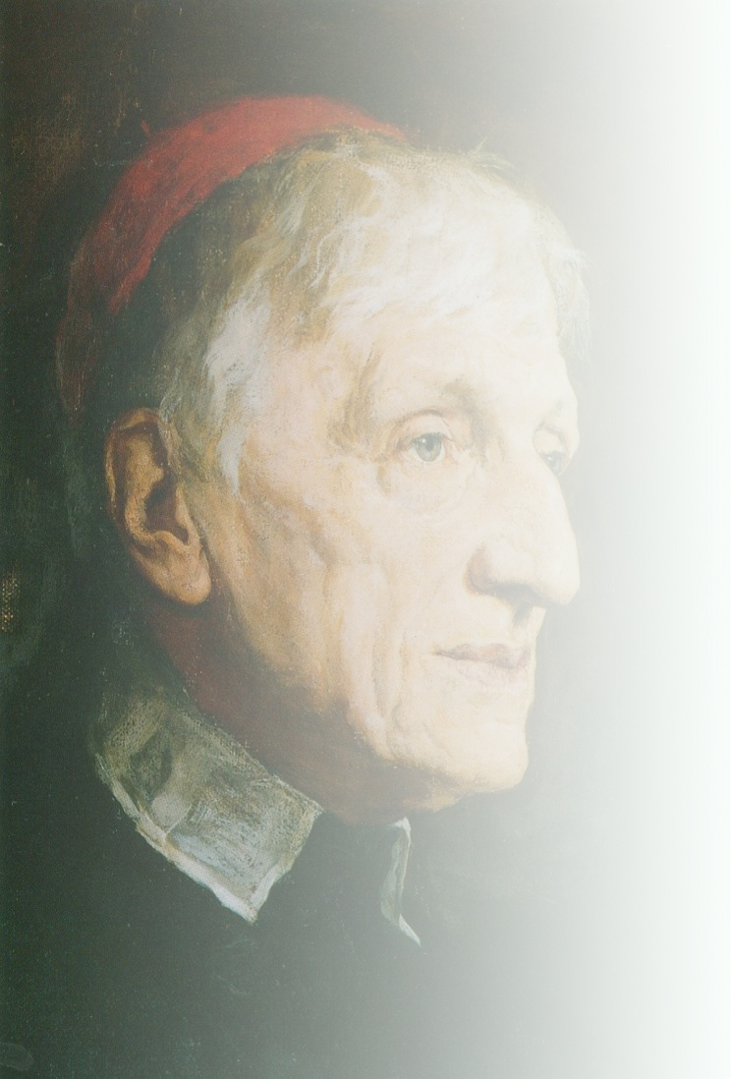
“God has created me
to do him some definite service.
He has committed some work to me
which he has not committed to another.
I have my mission.
I may never know it in this life,
but I shall be told it in the next.
I have a part in a great work.”
M I S S I O N
John Henry Newman (1801 – 90)
Meditations and Devotions (1893)
Notes:
Mission – end of section slide
“God has created me to do him some definite service. He has committed some work to me which he has not committed to another.
I have my mission. I may never know it in this life, but I shall be told it in the next. I have a part in a great work.” (John Henry Newman (1801 – 90), Meditations and Devotions)
[click – next slide]

Slide 12
3
St Ignatius College
Our Way of Proceeding
Notes:
Community – title slide
[click – next slide]

Slide 13
Titles : Calibri 36pt
Text : Calibri 24pt
Quotations : Constantia 24pt blue
Quotation references : Calibri 14pt grey
C O M M U N I T Y
Notes:
Community – template slide
[click – next slide]

Slide 14
C O M M U N I T Y
Xxxx
Xxxx
Xxxx
Notes:
Pause for thought.
[5-minutes to reflect and share with the person next to you]
[click – next slide]

Slide 15
“Jesuit schools should be . . .
places where people are believed in, honoured and cared for;
where natural talents and creative abilities are recognized and celebrated;
where individual contributions and accomplishments are appreciated;
where everyone is treated fairly and justly;
where sacrifice on behalf of the economically poor, the socially deprived,
and the educationally disadvantaged is commonplace;
where each of us finds the challenge, encouragement and support
we need to reach our fullest individual potential for excellence;
where we help one another and work together with enthusiasm and generosity,
attempting to model concretely in word and action the ideals we uphold.”
C O M M U N I T Y
Ignatian Pedagogy n.37
Notes:
Community – end of section slide
“Jesuit schools should be
places where people are believed in, honoured and cared for;
where natural talents and creative abilities are recognized and celebrated;
where individual contributions and accomplishments are appreciated;
where everyone is treated fairly and justly;
where sacrifice on behalf of the economically poor, the socially deprived,
and the educationally disadvantaged is commonplace;
where each of us finds the challenge, encouragement and support
we need to reach our fullest individual potential for excellence;
where we help one another and work together with enthusiasm and generosity,
attempting to model concretely in word and action the ideals we uphold.” (Ignatian Pedagogy n.37)
[click – next slide]

Slide 16
SHARED VISI N
Jesuit Spirit in Education
and finally!
Notes:
4 And Finally!
As we come to the end of these first four sessions of the Shared Vision Induction course, I hope that you now have a richer and deeper understanding of what Jesuit schools are, why they do some of the things they do, what they desire for their pupils, and how you have an important part to play.
But what next?
[click – next slide]

Slide 17

Next steps
Shared Vision
i
One session in the summer term
Reviewing your experience of Jesuit education after a year
Shared Vision
1
Two-day residential course looking in greater
depth at the tradition of Jesuit education and Jesuit schools
Shared Vision
2
Two-day residential course exploring the Jesuit method of teaching and learning
Retreat
Opportunities to experience the spirituality of St Ignatius for yourself.
Notes:
There is one more session in this Shared Vision Induction course and this will take place in the summer term when you have more experience of a Jesuit school to reflect upon and discuss.
This course is the first step in a series of Shared Vision courses offered to teachers, teaching assistants and support staff in Jesuit schools.
[click]
Shared Vision 1 is a two-day residential course which looks in greater depth at the tradition, story and vision of Jesuit education.
Shared Vision 2 is also a two-day residential course which explores the Jesuit classroom and the Jesuit method of teaching and learning.
You can do either or both of these courses once you have completed Shared Vision Induction.
[click]
You will also have the opportunity to participate in retreats, here at school or on an individually guided retreat at a residential retreat house. This is so that you can experience the spirituality, and spiritual exercises, of St Ignatius first hand.
I hope you will feel encouraged to continue to build up your own knowledge and practice of Jesuit education through Shared Vision.
[click – next slide]

Slide 18

excellence of teaching
promoting and using the Jesuit Pupil Profile
extending pupils’ horizons & giving new perspectives
outstanding pastoral care
extra-curricular activities
school events & school community
charities & social outreach
chaplaincy programme
developing the shared vision of Jesuit education
Everything you contribute to the learning of your pupils and to the life of the school
makes this a Jesuit school.
Thank you!
Notes:
Secondly, I would encourage you to pick up those Ignatian themes of generosity and active involvement and make them your own.
Everyone contributes to the success of a Jesuit school – we all do it in different ways.
We recognise that teachers and support staff come from a variety of religious backgrounds, or none. Some will be familiar and comfortable with the religious language that we use to speak about our Christian, Catholic and Jesuit identity and mission. Others may find in new and strange at first but understand the shared goals for the children that it articulates. Wherever you find yourself, we invite you to become part of the enterprise of Jesuit education at [Name of School].
[click]
We invite you to contribute from your own strengths and gifts. We ask you to think about the ‘magis’ – that Ignatian idea of the ‘more’ – and to consider how you can best play your own part in this school:
Excellence of teaching
Promoting and using the Jesuit Pupil Profile
Extending pupils’ horizons and giving new perspectives
Outstanidng pastoral care
Extra-curricular activities
School events & school community
Charities & social outreach
Chaplaincy programme
Developing the shared vision of Jesuit education
Everything you contribute to the learning of your pupils and to the life of the school makes this a Jesuit school.
[by way of illustration, the leader of the session may wish to give some practical examples of the wide variety of contributions that staff actually make]
[click – next slide]

Slide 19


a 450-year old tradition
2,232 schools
186 universities
3½-million pupils and students
in 70 countries on six continents
with 130,000 lay and Jesuit educators
a global system of education
across religious and cultural divides
one vision ‘improvement in living and learning’
for the greater glory of God and the common good
Welcome!
Notes:
As well as contributing to the life and learning of this school, remember that you are part of something much older and much bigger . . .
[give time for slide to play – it is not necessary to read out the text]
a 450-year old tradition
2,232 schools
186 universities
3½-million pupils and students
in 70 countries on six continents
with 130,000 lay and Jesuit educators
a global system of education
across religious and cultural divides
one vision ‘improvement in living and learning’
for the greater glory of God and the common good
Welcome!
[click – end slide]

Slide 20
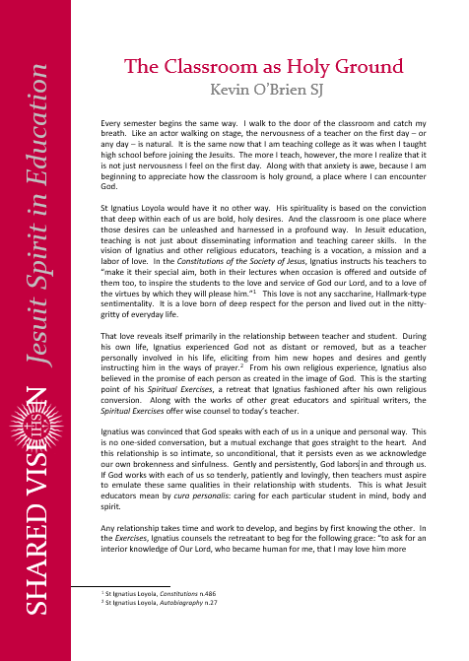

Some further reading . . .
Notes:
Some further reading:
The Classroom as Holy Ground
[click – next slide]

Slide 21
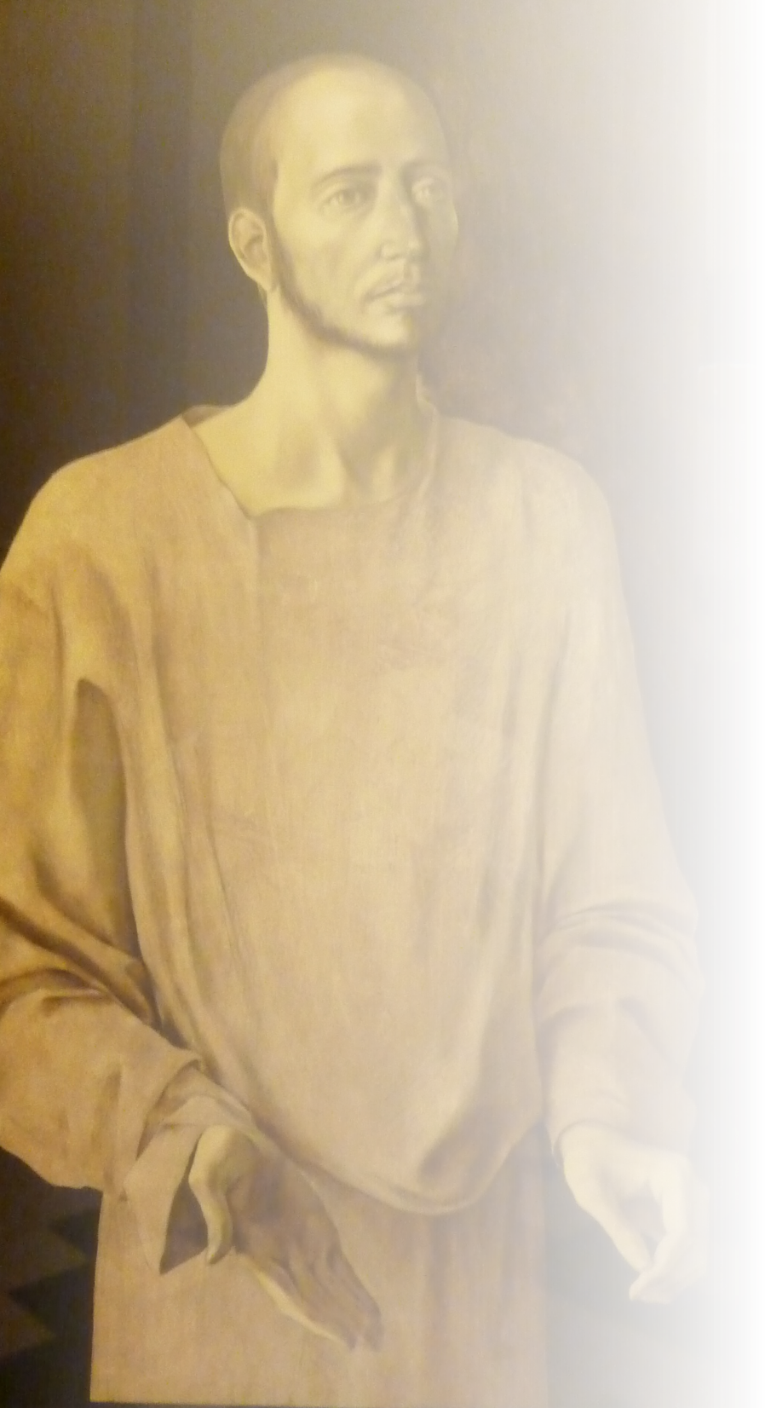
Lord,
teach me to be generous:
to serve you as you deserve;
to give and not to count the cost;
to fight and not to heed the wounds;
to toil and not to seek for rest;
to labour and to ask for no reward
save that of knowing I do your will.
Amen.
Notes:
[invitation to closing prayer . . .]
Lord,
teach me to be generous:
to serve you as you deserve;
to give and not to count the cost;
to fight and not to heed the wounds;
to toil and not to seek for rest;
to labour and to ask for no reward
save that of knowing I do your will.
Amen.
[click – next slide]

Slide 22

SHARED VISI N
Jesuit Spirit in Education
2017
Notes:
[End]

